Slide 1
Presented by : Aayushi Ojha
Ishwor Khatiwada
Kristina Udash
Rebika Swar
Sarahana Suwal
Operating system installation

Slide 2
Content
Introduction to Operating system
Function of Operating system
Memory Management
Processor Management
Device Management
File Management
Disk partition and formatting
OS installation procedure

Slide 3
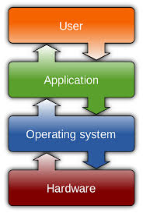
INTRODUCTION (OS)
OS is the software component of a computer system
Responsible for the management and coordination of
activities and the sharing of the resources of the computer.
OS offer a number of services to application programs and users.
OS acts as a host for application programs that are run on the machine.
As a host, one of the purposes of an OS is to handle the details of the operation of the hardware.
Users may also interact with the OS by typing commands or using a graphical user interface (GUI).
Your
Content
You can simply impress your audience and add a unique zing and appeal to your Presentations.
You can simply impress your audience and add a unique zing and appeal to your Presentations. Easy to change colors, photos and Text. Get a modern PowerPoint Presentation that is beautifully designed. I hope and I believe that this Template will your Time, Money and Reputation. Easy to change colors, photos and Text.
You can simply impress your audience and add a unique zing and appeal to your Presentations.
You can simply impress your audience and add a unique zing and appeal to your Presentations.

Slide 4
Important functions of OS
1. I/O Management
2. Memory Management
8. Resource Allocation
3. Process Management
7. Communication
4. Device Management
6. Error Detection
5. File Management

Slide 5
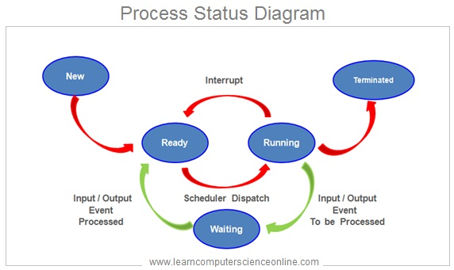
Process Management
It helps to manage and function the programs in the correct order
Suspending and resuming processes
Providing mechanism for process synchronization
Providing mechanism for process communication
It also protects the resources of each process from other methods and allows synchronization among processes.

Slide 6
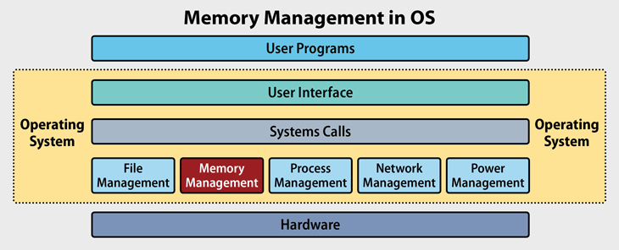
Memory Management
It handles or manages primary memory and moves processes back and forth between main memory and disk during execution
Keeps track of each and every memory location
Checks how many memory is to be allocated
Decides which process will get memory at what time
Tracks whenever some memory gets freed or unallocated and correspondingly it updates the status

Slide 7
DEVICE MANAGEMENT
Device management is another main function of an operating system.
An operating system is responsible for managing all the hardware devices of the computer system. It may include the management of storage device as well as the management of all the input and output devices. It is the responsibility of the operating system to keep track of the status of all the devices of the computer system. An operating system manages the devices in computer system with the help of device controllers and device drivers.

Slide 8
SOME IMPORTANT POINTS OF DEVICE MANAGEMENT
1.An operating system communicates with the devices controllers with the help of device drivers while allocating the device to the various processes running on the computer system.
2.Device drivers are the software programs that are used by an operating system to control the functioning of various devices in uniform manner.
3.The device drivers may also be regarded as the system software programs program acting as an intermediary between the processes and the device controllers.
4.The device controllers used in the device management operation usually includes three different registers command, status, and data.
5.The other major responsibility of the device management function is to implement the Application Programming Interface(AIP).

Slide 9
FILE MANAGEMENT
File management is one of the basic and important features of operating system. Operating system is used to manage the files of computer system. All the files with different extension are managed by operating system.

Slide 10
Some tasks performed by file management.
1. It helps to create a new files in computer system and placing them at the specific locations.
2. It helps in easily and quickly locating these files in computer system.
3. It makes the process of sharing of files among different users very easy and user friendly.
4. It helps to store the files in separate folders known as directories.
5. It helps the user to modify the data of files or to modify the name of the file in the directories.

Slide 11
HARD DISK STRUCTURE
It is an electro-mechanical data storage device that uses magnetic storage to store and retrieve information using one or more rotating disks (platters).
A platter is a circular, metal disk that is mounted inside a hard disk drive. Several platters are mounted on a fixed spindle motor to create more data storage. IT is made up of aluminum or glass substrate.
Each platter is broken into thousands of tightly packed concentric circles, known as tracks.
Each track is further broken down into smaller units called sectors.
A single track typically can have thousands of sectors and each sector can hold more than 512 bytes of data.
The heads are an interface between the magnetic media where the data is stored and electronic components in the hard disk. The heads convert the information, which is in the form of bits to magnetic pulses when it is to be stored on the platter and reverses the process while reading.

Slide 12
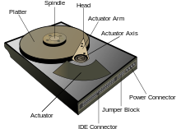

Slide 13
Partitioning
Disk partition or partition is a section of the hard drive that is separated from other segments.
It enable users to divide a physical disk into logical sections. For example, allowing multiple operating systems to run on the same device.
Separating valuable files to minimize corruption risk. Allocating specific system space, applications, and data for specific uses
How to partition a hard drive
Step 1: Select my computer, left-click, select manage OR Type partition into the search bar.
Step 2: Select disk-management/Right-click on any drive ,select Shrink Volume.
Step 3: Click on Mark your new partition/New simple volume.

Slide 14
FORMATTING A HARD DRIVE
Open the Computer/My Computer/This PC
Right-click on the drive you want to format.
Select the file system.
(If (Internal drive)using it with your Windows computer, select NTFS. If the drive is external, select FAT32 or exFAT)
Choose whether or not to Quick Format. ...
Start the format.OR
STEP 1: Open Command Prompt As Administrator.
STEP 2: Type List Disk.
STEP 4: Select the Drive to Format.
STEP 5: Clean the Disk.
STEP 6: Create Partition Primary.
STEP 7: Format the Drive.

Slide 15
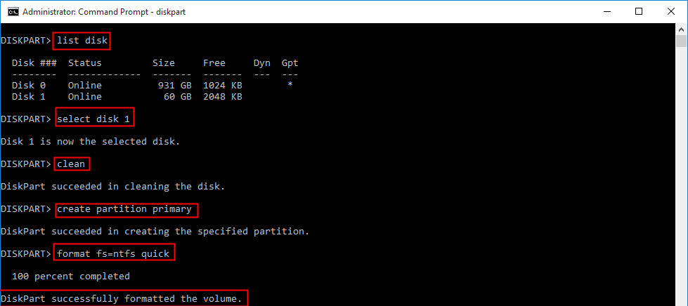

Slide 16
BOOT A DRIVE/LOADING OS
Insert the installation disk or flash drive. Restart your computer.
Press and hold Del or F2 to enter the BIOS page.
Locate the "Boot Order" section
Save your settings and exit the BIOS and Restart computer.
Follow the on-screen prompts for account date time internet settings and storage of OS drives/ partition of drives.
.

Slide 19
Problems during OS Installation
LOW DISK SPACE
ISO IMAGE ISSUE
ERROR CODE
INCOMPATIBLE HARDWARE

Slide 20
TROUBLESHOOTING
We should unplug any unnecessary devices from computer like flash drives and dongles. Laptops should have nothing plugged in at all (except a power cord), and desktops should only have a monitor, mouse, and keyboard attached.
. If PC includes an integrated graphics card or sound card on the motherboard, we should remove any standalone cards and Unplug any secondary storage drives (but not the primary OS drive)like: disc drives, card readers, and extra hardware such as a fan controller or USB extension connected to a PCI port.

Slide 21
TROUBLESHOOTING
While upgrading your PC, we should select a standard upgrade that preserve programs, remove unnecessary programs before beginning the installation process
If installation is not complete, or if we have issues with startup, we can disable hibernation, by typing “powercfg /h off” into a Command Prompt window.
To install “cleanly,” (preserving your personal files but not the programs). To do so, we should select “Custom: Install Windows” instead of “Upgrade” during the setup process. Then we can re-install programs later.

Slide 22
THANK YOU

Slide 23
ANY QUESTIONS??

